Slide 1



Balance Sheet Analyzer AI
Author: Anusha Dadam
Videos link :https://drive.google.com/drive/folders/1UyYOz-x6UAWtYkxwe5bzRsIx7C-uh5Sm
Network URL: http://192.168.31.67:8501

Slide 2

CONTENTS
1. Objective
2. Approach and Methodology
3. Features Summary
4. Findings & Key Learnings
5. Limitations & Next Steps
6. Conclusion

Slide 3

Objective
The goal of this project is to simplify the financial analysis of corporate balance sheets by leveraging AI models.
The system allows users with different roles—Analyst, CEO, and Top Management—to securely log in, upload annual reports in PDF format, extract structured financial data using AI, visualize financial trends, and interact with an intelligent assistant for actionable insights.

Slide 4

Authentication and Role-Based Access
Users must log in to access the application.
The system checks credentials via the SQLite database (users table).
Based on the user's role, the application grants access to certain features:
• Analyst: Can upload new PDF reports and view all companies' data.
• CEO: Can view data and AI insights for only their assigned company.
• Top Management: Can view all companies under the group and use AI assistance for deeper analysis.
This is enforced using helper functions like check_login() and check_role_access() in auth.py.

Slide 5

PDF Processing (Step-by-Step Extraction)
Uploaded annual reports (PDF files) are processed page by page using the pdfplumber library:
Step 1
Step 2
Text is extracted from each page and saved as a list of strings.
Each page’s text is passed through an AI model for financial data extraction.

Slide 6


AI-Based Financial Data Extraction
To extract structured financial data from the unstructured PDF text, the system uses the Groq API with LLaMA 3 models (specifically llama3-8b-8192 and llama3-70b-8192):
1
2
3
4
Each page (and sometimes two consecutive pages) is analyzed.
The AI is instructed to return a valid JSON object containing only the required financial metrics (like Revenue, Net Profit, Total Assets, etc.).
If a value is missing, the AI sets it as null—ensuring transparency and no hallucinations.
Metrics are then cleaned, converted into float, and saved to the SQLite database.

Slide 7
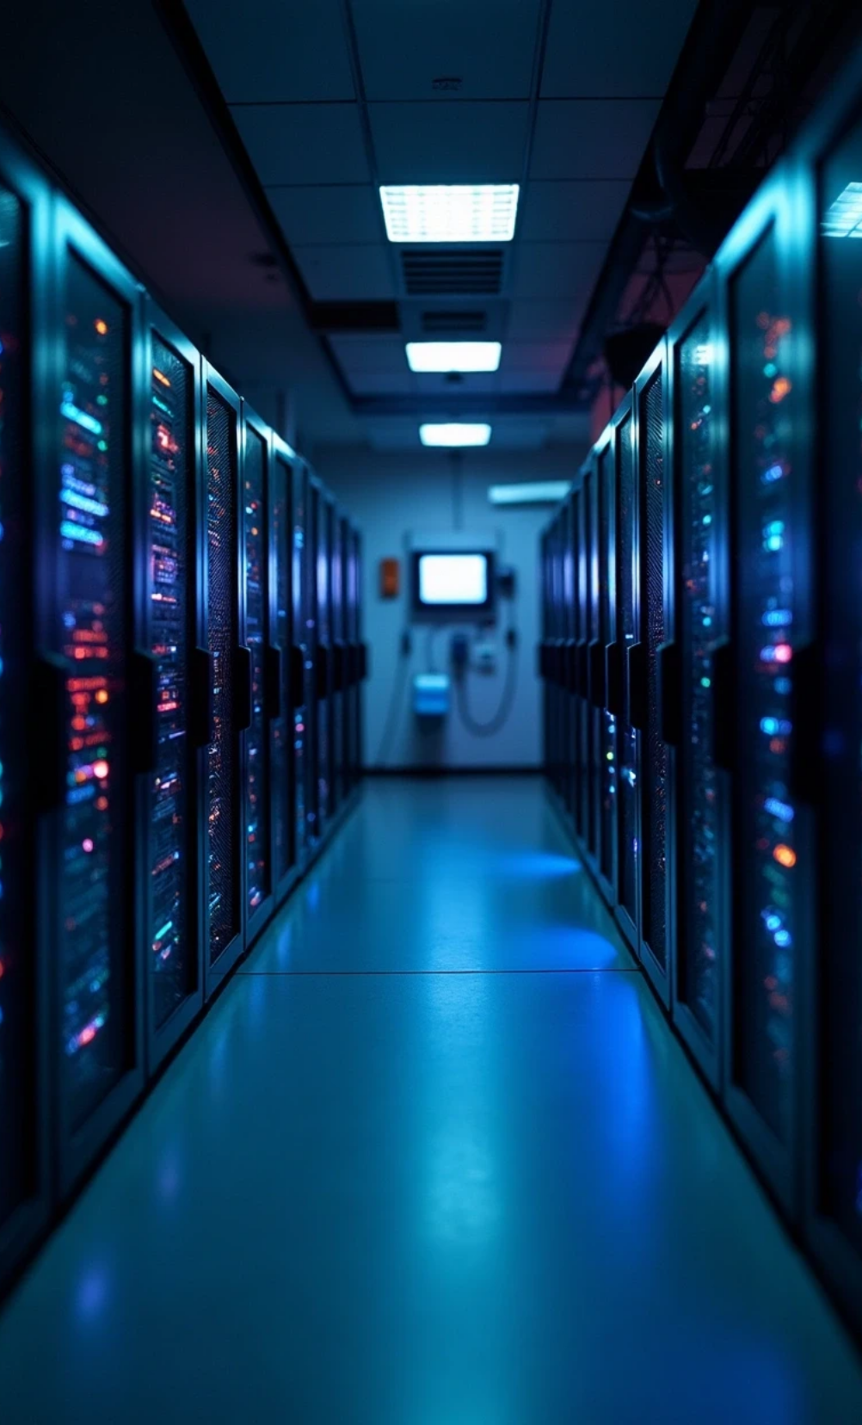


Why Groq?
Initially, OpenAI's GPT and Gemini 1.5 Flash were tested.
OpenAI had latency issues and a very limited number of free messages.
Gemini 1.5 Flash provided fast responses but also had message limits.
Groq + LLaMA 3 was chosen for its structured response capability, even though latency is slightly slower.

Slide 8


Data Visualization & Insights
Once data is saved, users can interact with visual charts and AI insights:
Plotly is used to create:
Users can ask the AI assistant questions like:
• Line charts (e.g., Net Profit over years)
• "How is the financial health of Reliance Jio?"
• Bar charts (e.g., Revenue comparison)
• "Show me the trend of Net Profit."
• Assets vs. Liabilities comparisons
• YoY Growth Charts
The assistant (powered by Groq) understands context, interprets trends, and gives concise and actionable summaries, especially tailored for busy decision-makers like CEOs and executives.

Slide 9

Features Summary
Feature | Description
Role-Based Access Control | Analyst, CEO, Top Management—each with different access permissions
Secure Login | Password authentication via SQLite
PDF Upload (Analyst only) | Only Analysts can upload and extract data from new annual reports
AI-Powered Data Extraction | LLMs extract structured JSON data from financial PDFs
Visual Insights | Charts for trends, growth, comparisons
Chat-Based AI Analyst | Users can ask financial questions and receive summarized insights

Slide 10
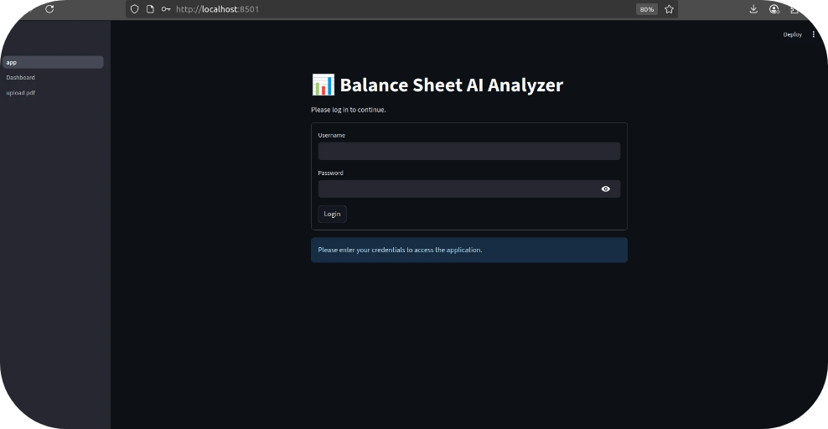
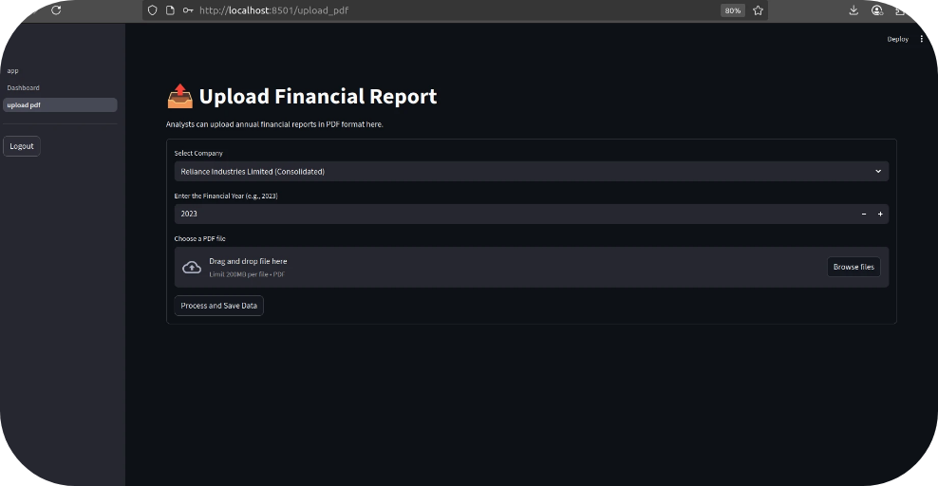
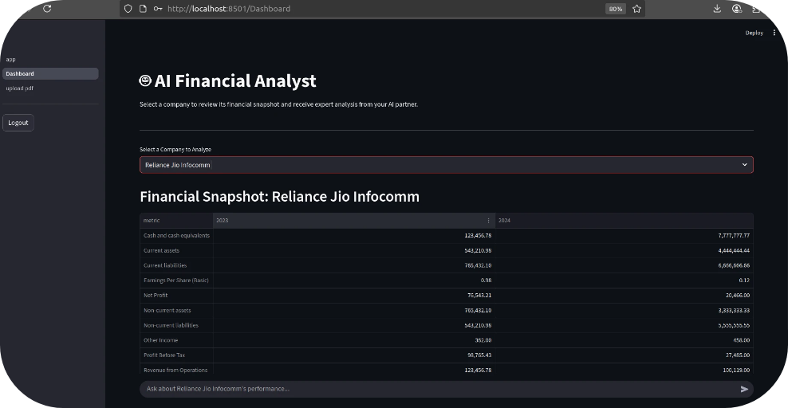
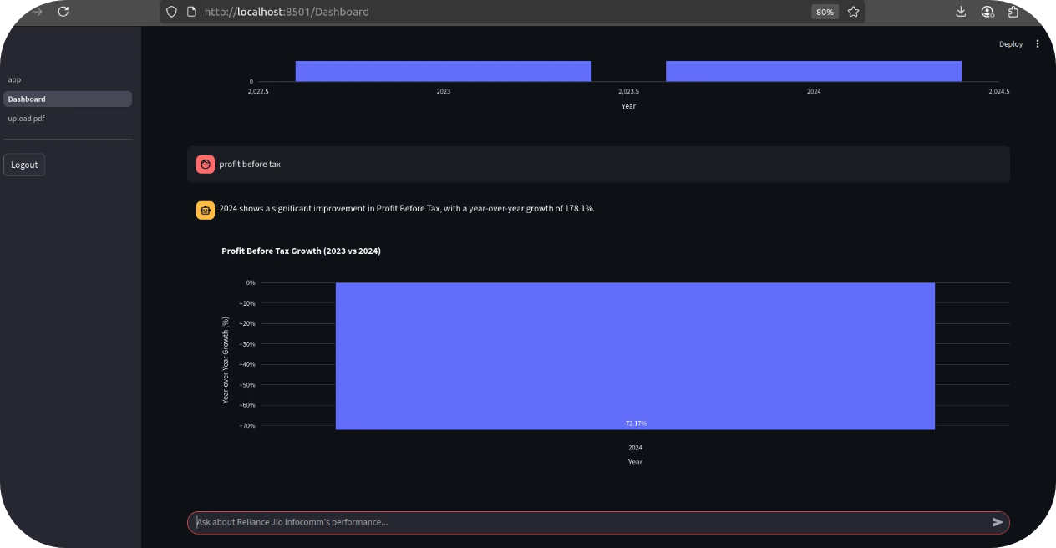
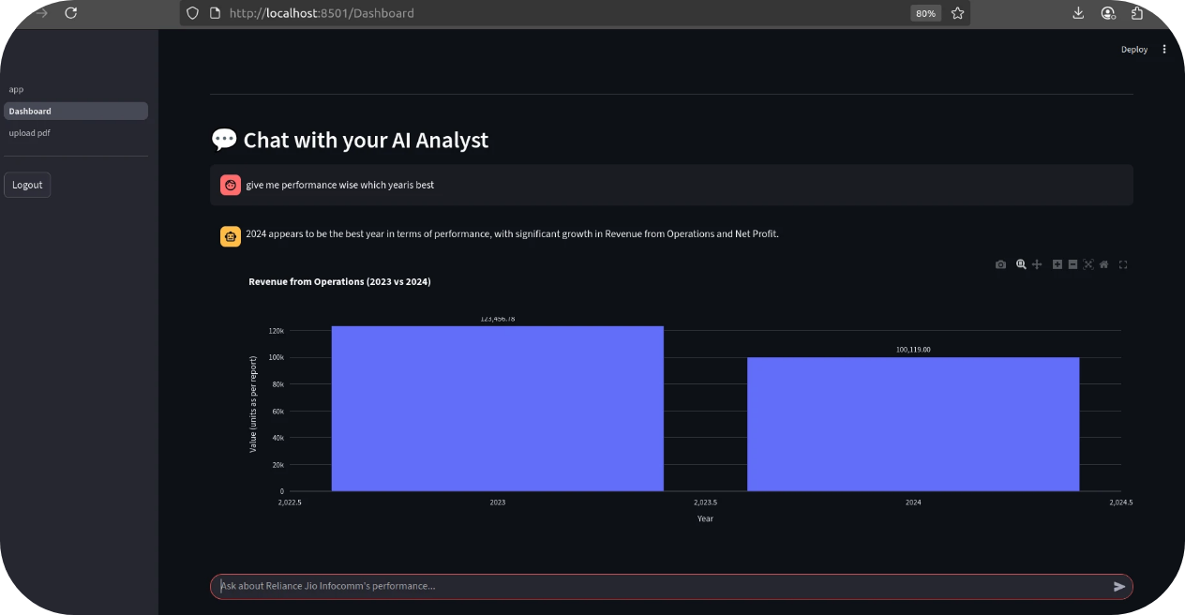
Frontend

Slide 11
Conclusion
This project demonstrates the effective use of AI to simplify financial analysis for diverse stakeholders. From data extraction to dynamic insights, the system transforms complex financial reports into interactive, insightful dashboards. With further refinement, this could serve as a robust tool for financial analysts and C-level executives.

Slide 12

Thank You

